Slide 1
COMP3050 Cloud Computing Technology

Slide 2
Intended Learning Outcomes
By the end of this lesson you will be able to:
Estimate your workload in this subject
Understand the main concepts and importance of cloud computing technology

Slide 3
COMP3050 Cloud Computing Technology

Slide 4

Cloud Computing Overview

Slide 5
Intended learning outcomes
After completing this topic, you will:
Understand the concept and origins of cloud computing
Appreciate why cloud computing matters
Be aware of its disadvantages

Slide 6
Cloud computing origin
Origin of the name
why “cloud”?
Origin of the technology
Evolution of cloud computing

Slide 7
Evolution of cloud computing
These technologies contributed to the making of cloud computing:
Time sharing
Global network
Virtualization
Web applications
Web services
…
Apart from the above, other trends and technologies contributed to the development of cloud computing as well. You can read about them in your reference books, find research papers and other online sources.

Slide 8
Time sharing
In the 1950s, companies started to use large mainframe computers, but it was too expensive to buy a computer for each user.

Slide 9
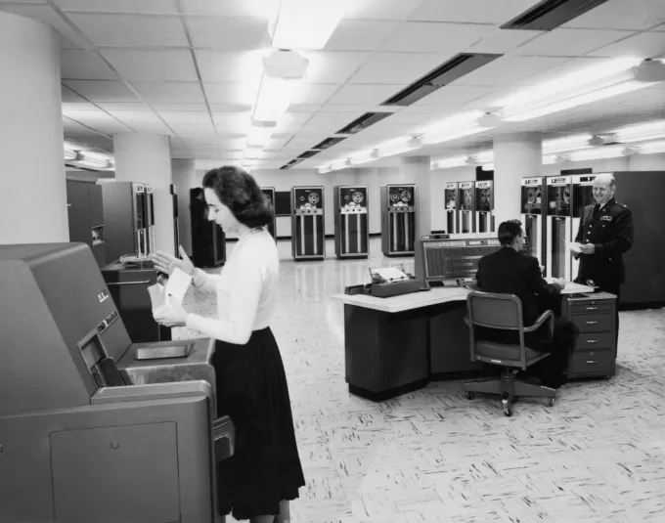
Main Frame
A typical corporate or computer installation had a suite of rooms,
a large, access-restricted, air-conditioned room for the computer
a smaller quieter room for submitting jobs

Slide 10
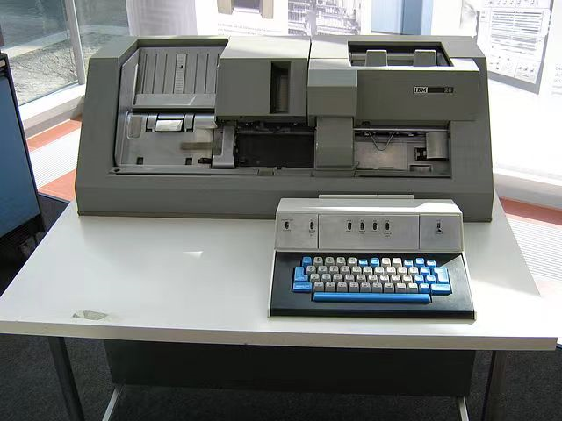
Main Frame
Nearby was a room full of keypunch machines for programmer use

Slide 11
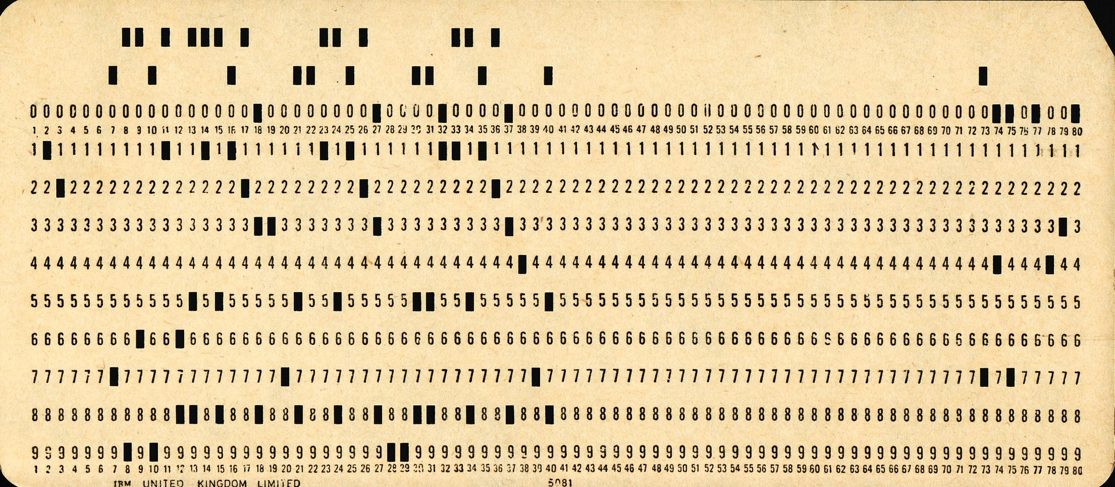
Main Frame
At that time, most computer programmers created, edited and stored their programs line by line on punch cards
a flexible write-once medium that encodes data

Slide 12
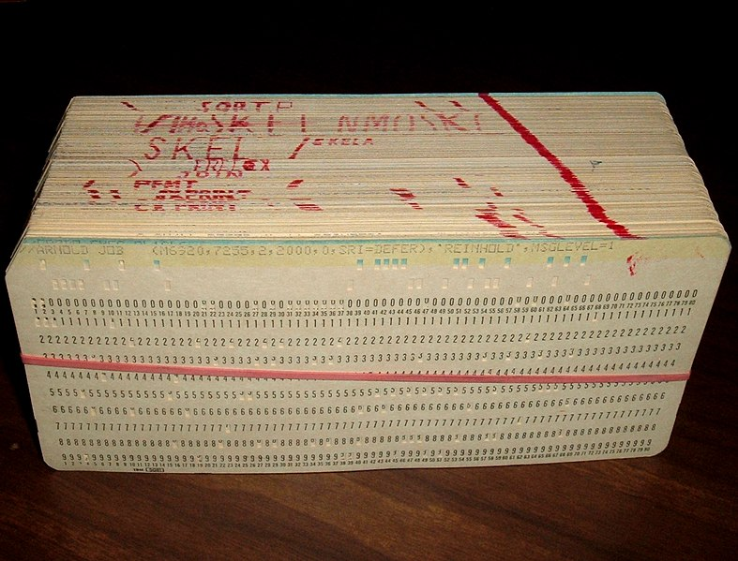
Main Frame
Groups or "decks" of cards form programs and collections of data

Slide 13
Main Frame
Programmers submitted the program decks, to be read by the program, to a person working behind a counter in the computer room

Slide 14
Main Frame
It could take hours or days between submitting a job to the computing center and receiving the output

Slide 15
Time sharing
In the 1950s, companies started to use large mainframe computers, but it was too expensive to buy a computer for each user.
So, during the late 1950s and early 1960s, a process called time sharing was developed to make more efficient use of expensive processor time on the central mainframe.
Time sharing enabled users to access numerous instances of computing mainframes simultaneously, maximizing processing power and minimizing downtime.
This idea represents the first use of shared computing resources, the foundation of modern cloud computing.

Slide 16
Global network
The origins of delivering computing resources using a global network are rooted in 1969 when American computer scientist J.C.R. Licklider helped create the Advanced Research Projects Agency Network, the so-called precursor to the internet.
Licklider's goal was to connect computers across the globe in a way that would enable users to access programs and information from any location.

Slide 17
Virtualization
It refers to the process of creating a virtual layer over the hardware which allows the user to run multiple instances simultaneously on the hardware.
In the 1970s, cloud computing began taking a more tangible shape with the introduction of the first VMs (virtual machines), enabling users to run more than one computing system within a single physical setup.

Slide 18
Web Applications
In the 1970s and 1980s, Microsoft, Apple and IBM developed technologies that enhanced the cloud environment and advanced the use of the cloud server and server hosting.
Then, in 1999, Salesforce became the first company to deliver business applications from a website.

Slide 19
Web Services
In 2006, Amazon launched AWS, providing such services as computing and storage in the cloud
Simple Storage Service (S3)
Elastic Compute Cloud (EC2)
These products pioneered the usage of server virtualization to deliver IaaS at a cheaper and on-demand pricing basis.
Following suit, the other major tech players, including Microsoft and Google, subsequently launched their own cloud offerings to compete with AWS

Slide 20
Cloud computing advantages

Slide 21
Cloud computing advantages
Cost savings
Increased productivity
Business continuity and disaster recovery

Slide 22

Cost savings
Money
Time

Slide 23

Money savings
Minimize up-front IT infrastructure costs
Minimize hardware cost
Minimize software cost
Minimize downtime cost
…

Slide 24
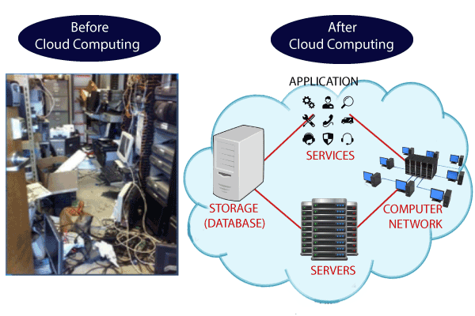
Minimize up-front IT infrastructure costs (1)
Companies can swap costly server centers and IT departments for fast Internet connections, where employees interact with the cloud online to complete their tasks.

Slide 25
Minimize up-front IT infrastructure costs (2)
Before cloud computing
Companies were required to purchase, construct, and maintain costly information management technology and infrastructure - server centres
a database server, mail server, networking, firewalls, routers, modem, switches, QPS (Query Per Second means how much queries or load will be handled by the server), configurable system, high net speed,
the maintenance engineers

Slide 26
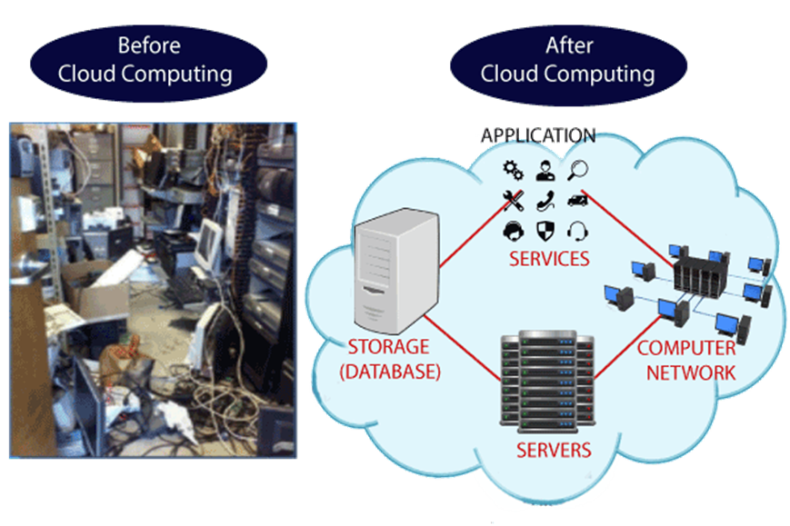
Minimize up-front IT infrastructure costs (2)
After cloud computing
They don't have to invest in hardware, facilities, utilities or building large data centers to accommodate their growing businesses.
Companies don't need large IT teams because they can rely on the expertise of their cloud providers' teams.

Slide 27
Minimize hardware cost
Traditional desktop software runs on desktop PC and demands high processing power and hard disk space– costly
Running cloud computing’s web-based applications does not require a high-powered and high-priced computer
PC can be less expensive, with a smaller hard disk, less memory, more efficient processor...

Slide 28
Minimize software cost
Instead of purchasing expensive software applications, companies can get most of wheat they need in the cloud
Many cloud computing applications are available for free
Instant software updates without high upgrade costs
When the application is web-based, updates happen automatically available the next time you log into the cloud
When you access a web-based application, you get the latest version without needing to pay for or download an upgrade

Slide 29
Minimize downtime cost
Cloud computing also cuts costs related to downtime
Downtime - the time during which a computer or IT system is unavailable, offline or not operational
Since downtime rarely happens in cloud computing, companies don't have to spend time and money to fix any issues that might be related to downtime

Slide 30

Time savings
Minimize application development time
Minimize management time
…

Slide 31
Minimize application development time
Cloud computing allows enterprises to get their applications up and running faster, with improved manageability and less maintenance

Slide 32
Minimize management time
Cloud computing enables IT teams to more rapidly adjust resources to meet fluctuating and unpredictable demand providing burst computing capability: high computing power at certain periods of peak demand.

Slide 33
Increased productivity
Improved data storage
Data and workload mobility
Improved collaboration

Slide 34
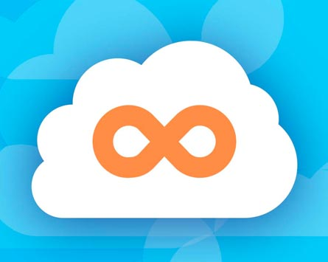
Improved data storage
Unlimited storage capacity
Cloud computing offers virtually limitless storage.
Increased data reliability
Even if your personal computer crashes, all your data is still out there in the cloud, still accessible

Slide 35

Data and workload mobility
Storing information in the cloud means that users can access it from anywhere with any device with just an internet connection
Remote employees are able to stay up to date with co-workers and customers

Slide 36

Improved collaboration (1)
Shared storage:
Sharing documents leads directly to better collaboration
Multiple users can collaborate easily on documents and projects
Colleagues can work together on documents housed in the cloud, with everyone able to access the same files and edit them in real-time.

Slide 37
Improved collaboration (2)
Improved document format compatibility.
You do not have to worry about the documents you create on your machine being compatible with other users' applications or OSes
There are potentially no format incompatibilities when everyone is sharing documents and applications in the cloud.

Slide 38
Improved collaboration (3)
Document version management
Cloud collaboration eliminates the confusion caused by having multiple versions of the same documents or the trials of attempting to merge resulting files

Slide 39
Improved collaboration (4)
Space and time decoupling
Cloud computing enables teams to work together and achieve their shared goals without being together physically in the workplace
Team members can view and edit the documents at any time

Slide 40
Business continuity and disaster recovery
All organizations worry about data loss. Storing data in the cloud guarantees that the data can be recovered even if
their local devices, e.g., laptops or smartphones, are inoperable
in the event of emergencies, such as natural disasters or power outages

Slide 41
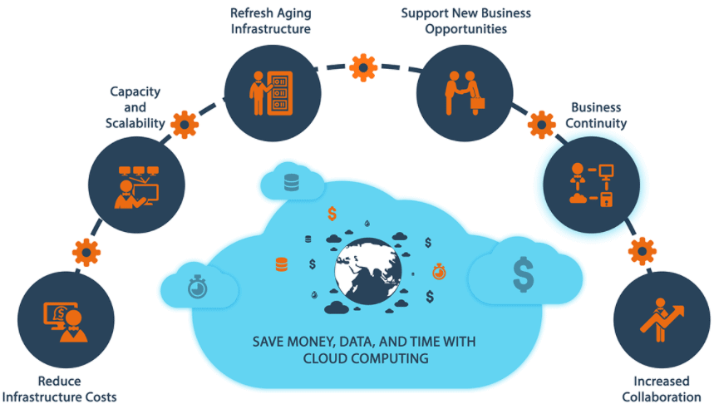

Slide 42
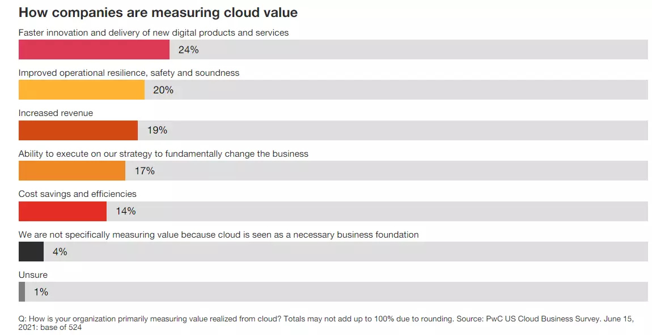

Slide 43
Cloud computing disadvantages

Slide 44
Cloud computing disadvantages
Cloud security
Cloud performance
Limited customization options
Cost unpredictability
Lack of capability and expertise
Compliance with industry laws
Complicated cloud migration
IT governance issues
Vendor lock-in

Slide 45
Cloud security
Security is often considered the greatest challenge facing cloud computing, especially when it comes to sensitive medical records and financial information.
When relying on the cloud, organizations risk
data breaches
hacking of APIs and interfaces
compromised credentials
authentication issues
Furthermore, there is a lack of transparency regarding how and where sensitive information entrusted to the cloud provider is handled.
Security demands careful attention to cloud configurations and business policy and practice.

Slide 46
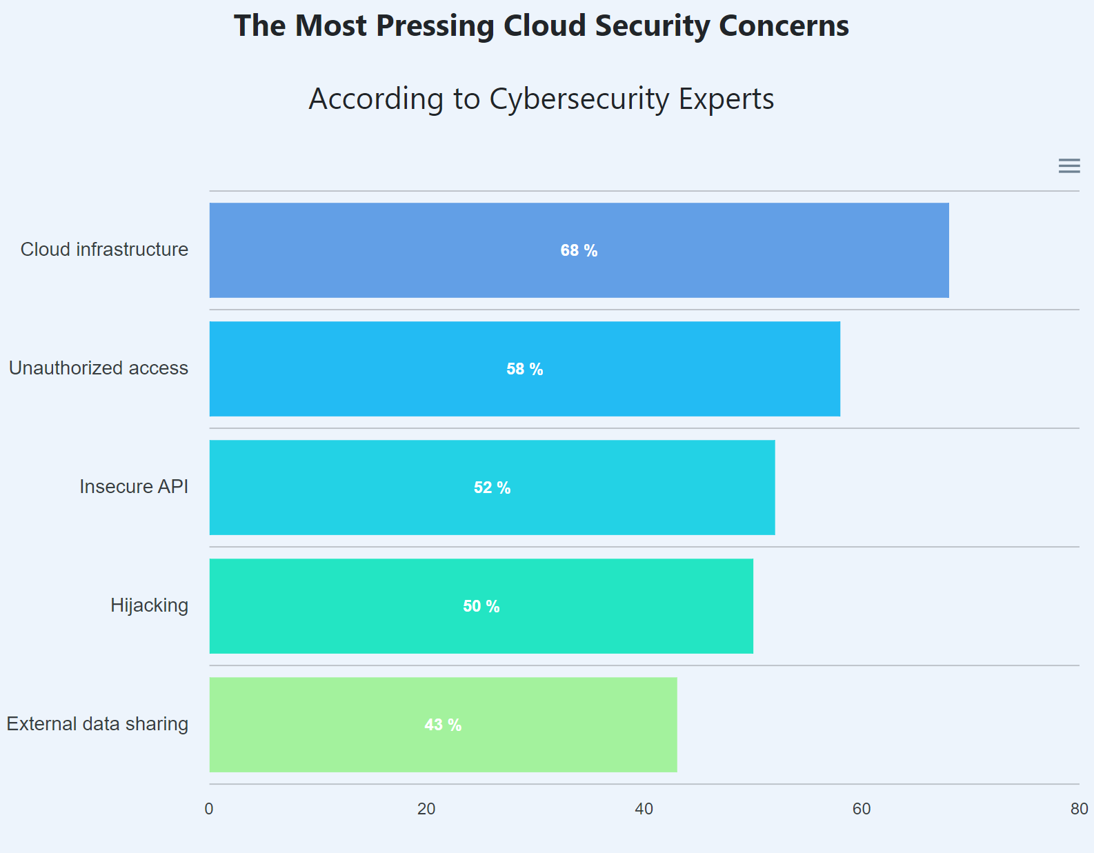

Slide 47
Cloud performance
Performance -- such as latency -- is largely beyond the control of the organization contracting cloud services with a provider.
Network and provider outages can interfere with productivity and disrupt business processes if organizations are not prepared with contingency plans.

Slide 48
Limited customization options
Cloud computing is cheaper because of economics of scale, but it offers fewer options at a much cheaper price
A restaurant with a limited menu is cheaper than a personal chef who can cook anything you want

Slide 49
Cost unpredictability
Pay-as-you-go subscription plans for cloud use, along with scaling resources to accommodate fluctuating workload demands, can make it tough to predict final costs

Slide 50
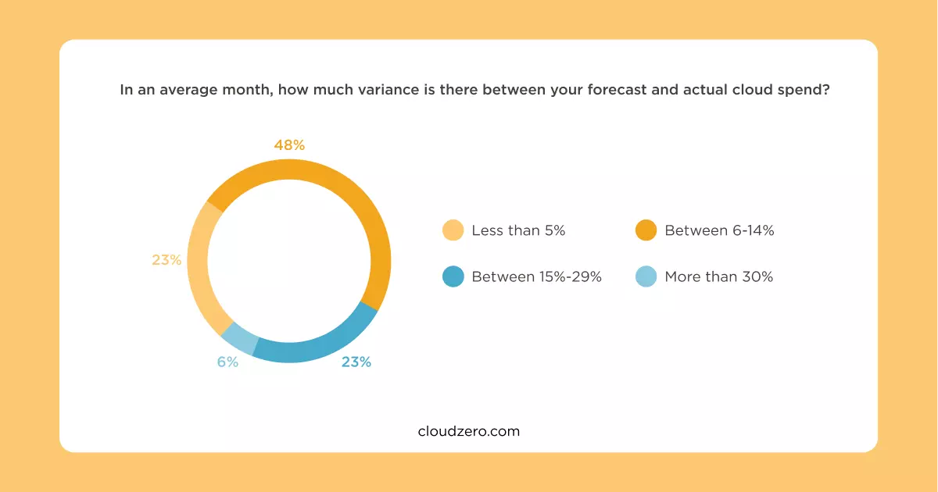

Slide 51
Lack of capability and expertise
With cloud-supporting technologies rapidly advancing, organizations are struggling to keep up with the growing demand for tools and employees with the proper skill sets and knowledge needed to architect, deploy, and manage workloads and data in a cloud.

Slide 52
Compliance with industry laws
When transferring data from on-premises local storage into cloud storage, it can be difficult to manage compliance with industry regulations through a third party.
It's important to know where data and workloads are actually hosted in order to maintain regulatory compliance and proper business governance.

Slide 53
Complicated cloud migration
The process of moving applications and other data to a cloud infrastructure often causes complications
Migration projects frequently take longer than anticipated and go over budget

Slide 54
IT governance issues
Cloud infrastructure is completely owned, managed, and monitored by the service provider, so the cloud users have less control over the function and execution of services within a cloud infrastructure.
This can make it challenging to properly manage risks and security, IT compliance and data quality.

Slide 55
Vendor lock-in
Often, switching between cloud providers can cause significant issues.
technical incompatibilities
legal and regulatory limitations
substantial costs incurred from sizable data migrations

Slide 56
The Flexera 2023 State of the Cloud Report
The survey tapped 750 IT professionals and executive leaders worldwide representing a broad cross-section of industries and context areas in the winter of 2022.
SMBs: Businesses with fewer than 1,000 employees
Enterprises: Organizations with 1,000+ employees
Large enterprises: Organizations with 10,000+ employees

Slide 57
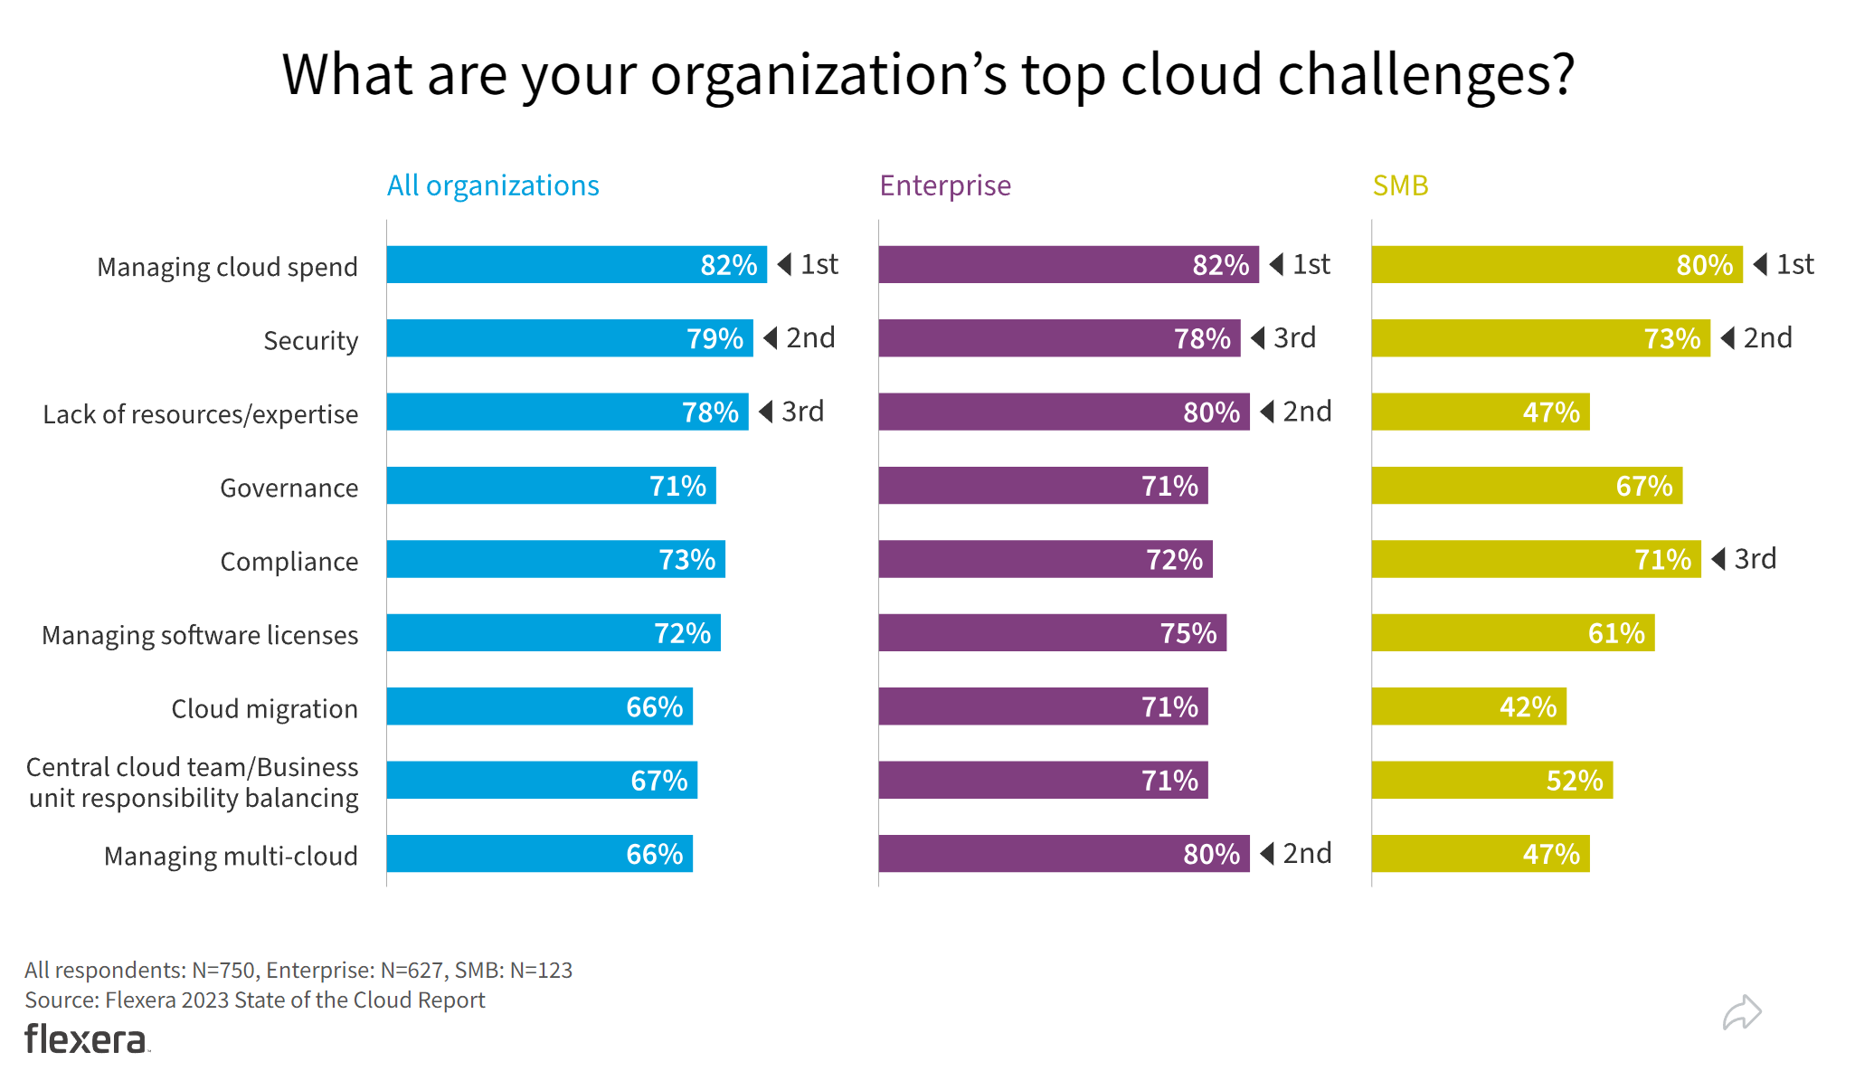

Slide 58
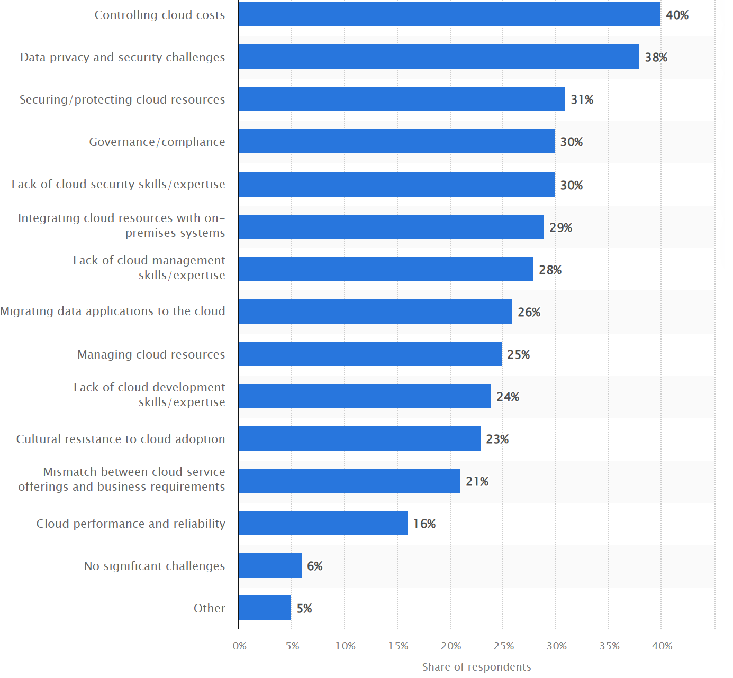
Top challenges/ obstacles for organizations for using public cloud resources 2020
Published by Lionel Sujay Vailshery, Feb 16, 2022

Slide 59
Summary (1)
Cloud computing is the delivery of different services through the Internet
The service types include software, infrastructure, platform and many others
They can be deployed in private clouds and public clouds, as well as their combination

Slide 60
Summary (2)
Characteristics of cloud computing (On-demand self-service, Broad network access, Resource pooling, Rapid elasticity, Measured service) evolved from various of technologies that contributed to the making of cloud computing
Time sharing
Global network
Virtualization
Web applications
Web services
…

Slide 61
Summary (3)
Cloud computing offers its users many advantages, but it also has disadvantages and there is an ongoing research to solve these problems

